Slide 1

15CSE313 Software Engineering
Design Concepts
Dr C.Arunkumar
Assistant Professor(Senior Grade), Dept of Computer Science and Engg
Amrita Vishwa Vidyapeetham, Coimbatore

Slide 2
Design Concepts
Pressman R S, Bruce R.Maxim, “Software engineering - A Practitioner’s Approach”, Eighth Edition, Tata McGraw-Hill, 2014
Chapter 12: 12.1-12.4
Chapter 13: 13.1, 13.3, 13.6

Slide 3
Topics Covered
Topic | Text Book Reference
Design Within the Context of Software Engineering | 12.1
The Design Process | 12.2
Design Concepts | 12.3
Software Architecture | 13.1
Architectural Styles | 13.3
Architectural Design | 13.6

Slide 4
Software Design
Software design encompasses the set of principles, concepts, and practices that lead to the development of a high-quality system or product
Design principles establish an overriding philosophy that guides the design work you must perform
Design concepts must be understood before the mechanics of design practice are applied, and design practice itself leads to the creation of various representations of the software that serve as a guide for the construction activity that follows
Design is pivotal to successful software engineering

Slide 5
DESIGN WITHIN THE CONTEXT OF SOFTWARE ENGINEERING
Software design sits at the technical kernel of software engineering and is applied regardless of the software process model that is used
Beginning once software requirements have been analyzed and modeled, software design is the last software engineering action within the modeling activity and sets the stage for construction (code generation and testing)
Each of the elements of the requirements model (Chapters 9–11) provides information that is necessary to create the four design models required for a complete specification of design

Slide 6
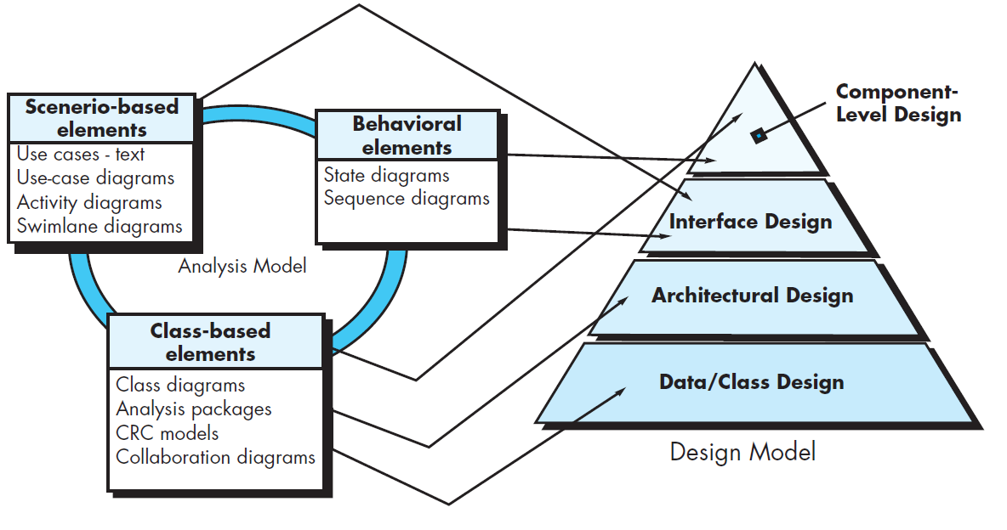
DESIGN WITHIN THE CONTEXT OF SOFTWARE ENGINEERING

Slide 7
Data/Class design
The data/class design transforms class models (Chapter 10) into design class realizations and the requisite data structures required to implement the software
The objects and relationships defined in the CRC diagram and the detailed data content depicted by class attributes and other notation provide the basis for the data design activity
Part of class design may occur in conjunction with the design of software architecture
More detailed class design occurs as each software component is designed

Slide 8
Architectural design
The architectural design defines the relationship between major structural elements of the software, the architectural styles and patterns (Chapter 13 that can be used to achieve the requirements defined for the system, and the constraints that affect the way in which architecture can be implemented
The architectural design representation—the framework of a computer-based system—is derived from the requirements model

Slide 9
Interface Design
The interface design describes how the software communicates with systems that interoperate with it, and with humans who use it
An interface implies a flow of information (e.g., data and/or control) and a specific type of behavior
Therefore, usage scenarios and behavioral models provide much of the information required for interface design

Slide 10
The design process
Software design is an iterative process through which requirements are translated into a “blueprint” for constructing the software
Initially, the blueprint depicts a holistic view of software
That is, the design is represented at a high level of abstraction—a level that can be directly traced to the specific system objective and more detailed data, functional, and behavioral requirements
As design iterations occur, subsequent refinement leads to design representations at much lower levels of abstraction
These can still be traced to requirements, but the connection is more subtle

Slide 11
Software Quality Guidelines and Attributes Three characteristics of a good design
The design should implement all of the explicit requirements contained in the requirements model, and it must accommodate all of the implicit requirements desired by stakeholders
The design should be a readable, understandable guide for those who generate code and for those who test and subsequently support the software
The design should provide a complete picture of the software, addressing the data, functional, and behavioral domains from an implementation perspective

Slide 12
Quality Guidelines
In order to evaluate the quality of a design representation, you and other members of the software team must establish technical criteria for good design
A design should exhibit an architecture that (1) has been created using recognizable architectural styles or patterns, (2) is composed of components that exhibit good design characteristics, and (3) can be implemented in an evolutionary fashion, thereby facilitating implementation and testing
A design should be modular; that is, the software should be logically partitioned into elements or subsystems
A design should contain distinct representations of data, architecture, interfaces, and components

Slide 13
Quality Guidelines
A design should lead to data structures that are appropriate for the classes to be implemented and are drawn from recognizable data patterns
A design should lead to components that exhibit independent functional characteristics
A design should lead to interfaces that reduce the complexity of connections between components and with the external environment
A design should be derived using a repeatable method that is driven by information obtained during software requirements analysis
A design should be represented using a notation that effectively communicates its meaning

Slide 14
Quality Attributes - FURPS
Functionality
Usability
Reliability
Performance
Supportability
is assessed by evaluating the feature set and capabilities of the program, the generality of the functions that are delivered, and the security of the overall system.
is assessed by considering human factors, overall aesthetics, consistency, and documentation
is evaluated by measuring the frequency and severity of failure, the accuracy of output results, the mean-time-to-failure (MTTF), the ability to recover from failure, and the predictability of the program
is measured using processing speed, response time, resource consumption, throughput, and efficiency
combines extensibility, adaptability, and serviceability

Slide 15
Design Concepts
Abstraction
Architecture
Patterns
Separation of concerns
Modularity
Information Hiding
Functional Independence
Refinement
Aspects
Refactoring
Object Oriented Design Concepts
Design Classes
Dependency Inversion
Design for Test

Slide 16
Abstraction
When you consider a modular solution to any problem, many levels of abstraction can be posed
Procedural abstraction refers to a sequence of instructions that have a specific and limited function
An example of a procedural abstraction would be the word open for a door
Open implies a long sequence of procedural steps (e.g., walk to the door, reach out and grasp knob, turn knob and pull door, step away from moving door, etc.).
A data abstraction is a named collection of data that describes a data object
In the context of the procedural abstraction open, we can define a data abstraction called door

Slide 17
Discussion
Provide examples of three data abstractions and the procedural abstractions that can be used to manipulate them

Slide 18
Architecture Structure or organization of program components (modules), the manner in which these components interact, and the structure of data that are used by the components
Structural models
represent architecture as an organized collection of program components.
Framework models
increase the level of design abstraction by attempting to identify repeatable architectural design frameworks (patterns) that are encountered in similar types of applications
Dynamic models
Address the behavioral aspects of the program architecture, indicating how the structure or system confi guration may change as a function of external events
Process models
focus on the design of the business or technical process that the system must accommodate
Functional models
can be used to represent the functional hierarchy of a system

Slide 19
Patterns
A pattern is a named nugget of insight which conveys the essence of a proven solution to a recurring problem within a certain context amidst competing concerns”
Stated in another way, a design pattern describes a design structure that solves a particular design problem within a specific context and amid “forces” that may have an impact on the manner in which the pattern is applied and used
The intent of each design pattern is to provide a description that enables a designer to determine
whether the pattern is applicable to the current work,
whether the pattern can be reused (hence, saving design time), and
whether the pattern can serve as a guide for developing a similar, but functionally or structurally different pattern

Slide 20
Separation of Concerns
Separation of concerns is a design concept that suggests that any complex problem can be more easily handled if it is subdivided into pieces that can each be solved and/or optimized independently
A concern is a feature or behavior that is specified as part of the requirements model for the software
By separating concerns into smaller, and therefore more manageable pieces, a problem takes less effort and time to solve

Slide 21
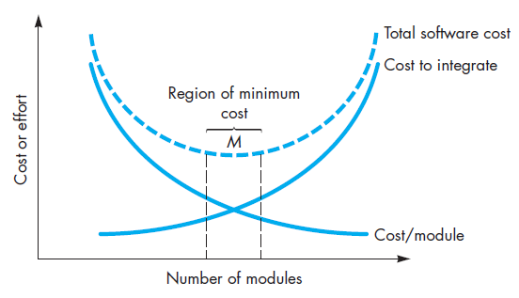
Modularity
Modularity is the most common manifestation of separation of concerns
Software is divided into separately named and addressable components, sometimes called modules, that are integrated to satisfy problem requirements
The effort (cost) to develop an individual software module does decrease as the total number of modules increases
Given the same set of requirements, more modules means smaller individual size
However, as the number of modules grows, the effort (cost) associated with integrating the modules also grows

Slide 22
Information Hiding
The principle of information hiding suggests that modules be “characterized by design decisions that (each) hides from all others.”
In other words, modules should be specified and designed so that information (algorithms and data) contained within a module is inaccessible to other modules that have no need for such information
Hiding implies that effective modularity can be achieved by defining a set of independent modules that communicate with one another only that information necessary to achieve software function
The use of information hiding as a design criterion for modular systems provides the greatest benefits when modifications are required during testing and later during software maintenance
Because most data and procedural detail are hidden from other parts of the software, inadvertent errors introduced during modification are less likely to propagate to other locations within the software

Slide 23
Functional Independence developing modules with “ single minded” function and an “aversion” to excessive interaction with other modules
Cohesion is an indication of the relative functional strength of a module
A cohesive module performs a single task, requiring little interaction with other components in other parts of a program
Stated simply, a cohesive module should (ideally) do just one thing
Although you should always strive for high cohesion (i.e., single-mindedness), it is often necessary and advisable to have a software component perform multiple functions
Coupling is an indication of the relative interdependence among modules
Coupling depends on the interface complexity between modules, the point at which entry or reference is made to a module, and what data pass across the interface
In software design, you should strive for the lowest possible coupling
Simple connectivity among modules results in software that is easier to understand and less prone to a “ripple effect” caused when errors occur at one location and propagate throughout a system

Slide 24
Refinement
Refinement is actually a process of elaboration
You begin with a statement of function (or description of information) that is defined at a high level of abstraction
That is, the statement describes function or information conceptually but provides no indication of the internal workings of the function or the internal structure of the information
You then elaborate on the original statement, providing more and more detail as each successive refinement (elaboration) occurs
Abstraction and refinement are complementary concepts
Abstraction enables you to specify procedure and data internally but suppress the need for “outsiders” to have knowledge of low-level details
Refinement helps you to reveal low-level details as design progresses. Both concepts allow you to create a complete design model as the design evolves

Slide 25
Aspects
As requirements analysis occurs, a set of “concerns” is uncovered
These concerns “include requirements, use cases, features, data structures, quality of service issues, variants, intellectual property boundaries, collaborations, patterns and contracts”
A crosscutting concern is some characteristic of the system that applies across many different requirements
An aspect is a representation of a crosscutting concern
In an ideal context, an aspect is implemented as a separate module (component) rather than as software fragments that are “scattered” or “tangled” throughout many components

Slide 26
Discussion
Identify a few aspects of your project

Slide 27
Refactoring
Refactoring is the process of changing a software system in such a way that it does not alter the external behavior of the code [design] yet improves its internal structure
When software is refactored, the existing design is examined for redundancy, unused design elements, inefficient or unnecessary algorithms, poorly constructed or inappropriate data structures, or any other design failure that can be corrected to yield a better design
Although the intent of refactoring is to modify the code in a manner that does not alter its external behavior, inadvertent side effects can and do occur
As a consequence, refactoring tools are used to analyze changes automatically and to “generate a test suite suitable for detecting behavioral changes.”

Slide 28
Object Oriented Design Concepts
The object-oriented (OO) paradigm is widely used in modern software engineering
Classes and objects, inheritance, messages, and polymorphism, among others

Slide 29
Design Classes – Five Types
User interface classes
define all abstractions that are necessary for human-computer interaction (HCI) and often implement the HCI in the context of a metaphor
Business domain classes
identify the attributes and services (methods) that are required to implement some element of the business domain that was defined by one or more analysis classes
Process classes
implement lower-level business abstractions required to fully manage the business domain classes
Persistent classes
represent data stores (e.g., a database) that will persist beyond the execution of the software
System classes
implement software management and control functions that enable the system to operate and communicate within its computing environment and with the outside world

Slide 30
Dependency Inversion
High-level modules (classes) should not depend [directly] upon low-level modules
Both should depend on abstractions
Abstractions should not depend on details
Details should depend on abstractions

Slide 31
Design for Test
There is an ongoing chicken-and-egg debate about whether software design or test case design (TDD) should come first
You need to provide appropriate test affordances—factoring your design in a way that lets test code interrogate and control the running system

Slide 32
Design Concepts - Summary
Abstraction
Architecture
Patterns
Separation of concerns
Modularity
Information Hiding
Functional Independence
Refinement
Aspects
Refactoring
Object Oriented Design Concepts
Design Classes
Dependency Inversion
Design for Test

Slide 33
Discussion
Suggest a design pattern that you encounter in a category of everyday things (e.g., consumer electronics, automobiles, appliances). Briefly describe the pattern.

Slide 34
Software Architecture
The software architecture of a program or computing system is the structure or structures of the system, which comprise software components, the externally visible properties of those components, and the relationships among them
The architecture is not the operational software. Rather, it is a representation that enables you to
analyze the effectiveness of the design in meeting its stated requirements,
consider architectural alternatives at a stage when making design changes is still relatively easy, and
reduce the risks associated with the construction of the software

Slide 35
Why is architecture important?
Software architecture provides a representation that facilitates communication among all stakeholders
The architecture highlights early design decisions that will have a profound impact on all software engineering work that follows
Architecture “constitutes a relatively small, intellectually graspable model of how the system is structured and how its components work together

Slide 36
Architectural Descriptions
An architectural description is actually a set of work products that reflect different views of the system
The blueprint metaphor - Developers regard architecture descriptions as a means of transferring explicit information from architects to designers to software engineers charged with producing the system components
The language metaphor views architecture as a facilitator of communication across stakeholder groups. This view is preferred by stakeholders with a high customer focus
The decision metaphor represents architecture as the product of decisions involving trade-offs among properties such as cost, usability, maintainability, and performance
The literature metaphor is used to document architectural solutions constructed in the past. This view supports the construction of artifacts and the transfer of knowledge between designers and software maintenance staff

Slide 37
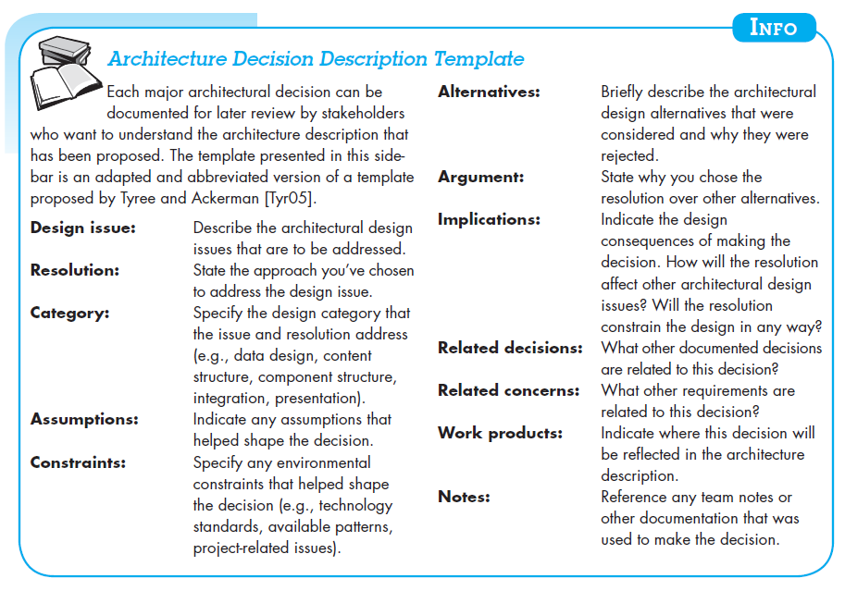
Architectural Decisions

Slide 38
Architectural Style Each style describes a system category that encompasses
A set of components (e.g., a database, computational modules) that perform a function required by a system,
A set of connectors that enable “communication, coordination and cooperation” among components,
Constraints that define how components can be integrated to form the system, and
Semantic models that enable a designer to understand the overall properties of a system by analyzing the known properties of its constituent parts

Slide 39
A Brief Taxonomy of Architectural Styles
Data-centered Architecture
Data-Flow Architecture
Call-and-Return Architecture
Object-Oriented Architecture
Layered Architecture

Slide 40
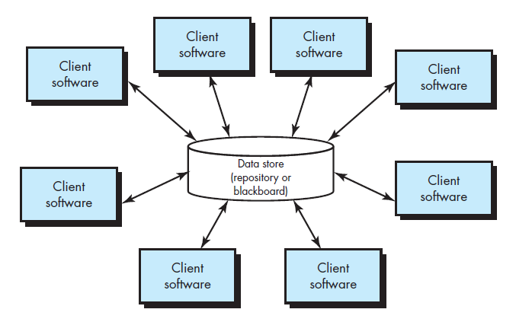
Data-Centered Architecture
A data store (e.g., a fi le or database) resides at the center of this architecture and is accessed frequently by other components that update, add, delete, or otherwise modify data within the store

Slide 41
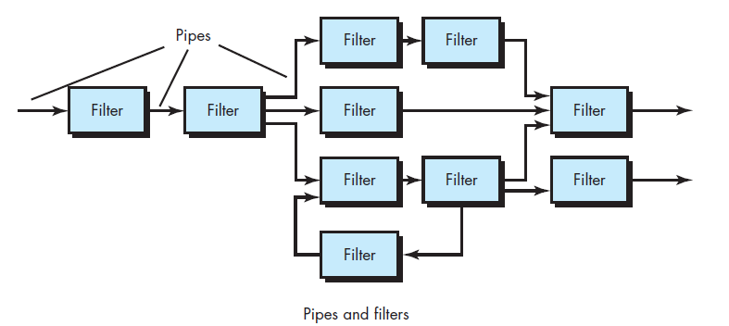
Data-Flow Architectures
This architecture is applied when input data are to be transformed through a series of computational or manipulative components into output data
A pipe-and-filter pattern has a set of components, called filters, connected by pipes that transmit data from one component to the next

Slide 42
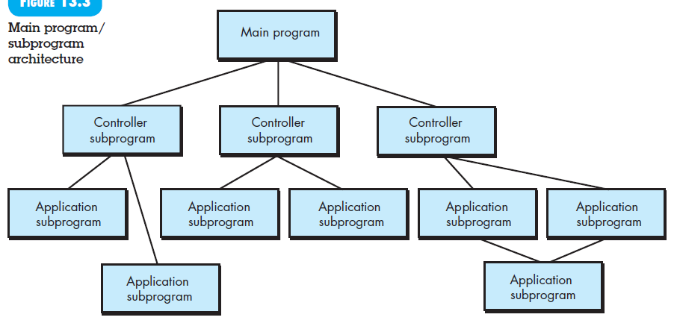
Call and Return Architectures
Main program/subprogram architectures

Slide 43
Object-Oriented Architectures
The components of a system encapsulate data and the operations that must be applied to manipulate the data
Communication and coordination between components are accomplished via message passing

Slide 44
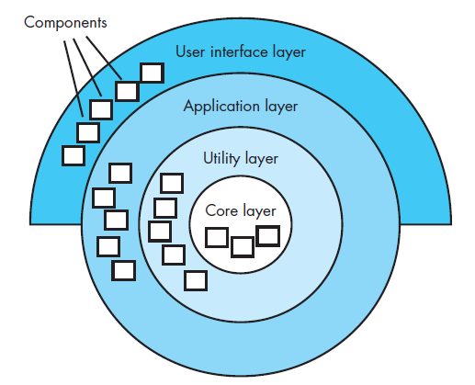
Layered Architectures
A number of different layers are defined, each accomplishing operations that progressively become closer to the machine instruction set
At the outer layer, components service user interface operations. At the inner layer, components perform operating system interfacing
Intermediate layers provide utility services and application software functions

Slide 45
Question?
Present two or three examples of applications for each of the architectural styles

Slide 46
Architectural Design
As architectural design begins, context must be established
To accomplish this, the external entities (e.g., other systems, devices, people) that interact with the software and the nature of their interaction are described
This information can generally be acquired from the requirements model
Once context is modeled and all external software interfaces have been described, you can identify a set of architectural archetypes

Slide 47
Architectural Design
An archetype is an abstraction (similar to a class) that represents one element of system behavior
The set of archetypes provides a collection of abstractions that must be modeled architecturally if the system is to be constructed, but the archetypes themselves do not provide enough implementation detail
Therefore, the designer specifies the structure of the system by defining and refining software components that implement each archetype
This process continues iteratively until a complete architectural structure has been derived

Slide 48
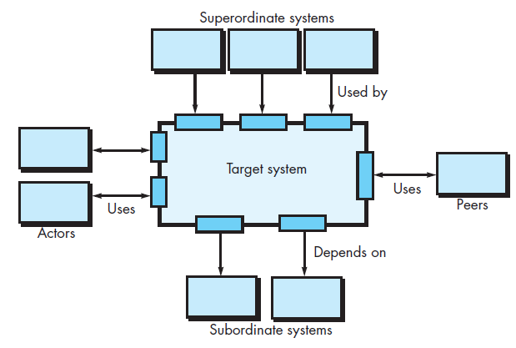
Representing the System in Context
At the architectural design level, a software architect uses an architectural context diagram (ACD) to model the manner in which software interacts with entities external to its boundaries

Slide 49
Representing the System in Context
Superordinate systems —those systems that use the target system as part of some higher-level processing scheme
Subordinate systems —those systems that are used by the target system and provide data or processing that are necessary to complete target system functionality
Peer-level systems —those systems that interact on a peer-to-peer basis
Actors —entities (people, devices) that interact with the target system by producing or consuming information that is necessary for requisite processing

Slide 50
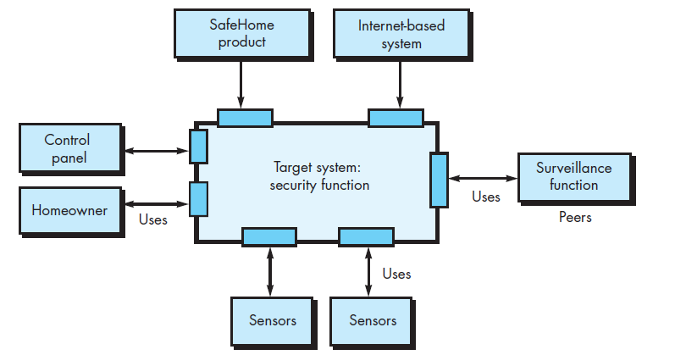
Architectural context diagram for the SafeHome security function

Slide 51
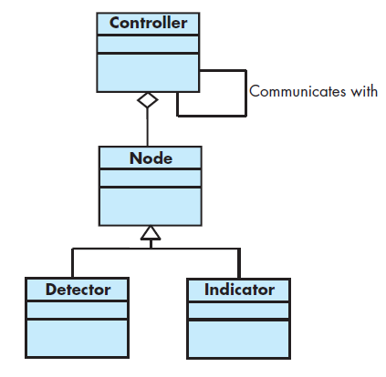
Defining Archetypes
An archetype is a class or pattern that represents a core abstraction that is critical to the design of an architecture for the target system
In general, a relatively small set of archetypes is required to design even relatively complex systems
UML relationships for SafeHome security function archetypes

Slide 52
Refining the architecture into components
As the software architecture is refined into components, the structure of the system begins to emerge
The interfaces depicted in the architecture context diagram imply one or more specialized components that process the data that flows across the interface
In some cases (e.g., a graphical user interface), a complete subsystem architecture with many components must be designed

Slide 53
Refining the architecture into components SafeHome example
External communication management —coordinates communication of the security function with external entities such as other Internet-based systems and external alarm notification
Control panel processing —manages all control panel functionality
Detector management —coordinates access to all detectors attached to the system
Alarm processing —verifies and acts on all alarm conditions

Slide 54
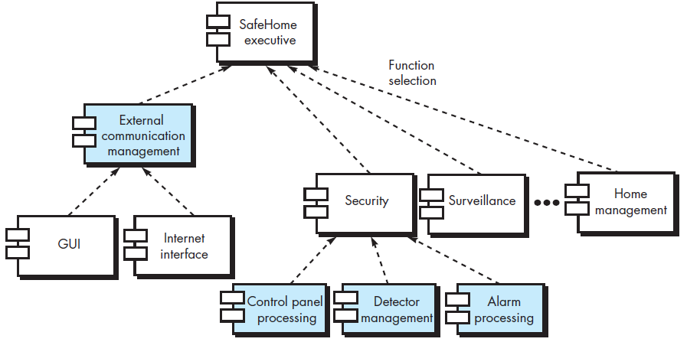
Overall architectural structure for SafeHome with top-level components

Slide 55
Describing Instantiations of the System
The architectural design that has been modeled to this point is still relatively high level
For further refinement, an actual instantiation of the architecture is developed
By this we mean that the architecture is applied to a specific problem with the intent of demonstrating that the structure and components are appropriate

Slide 56
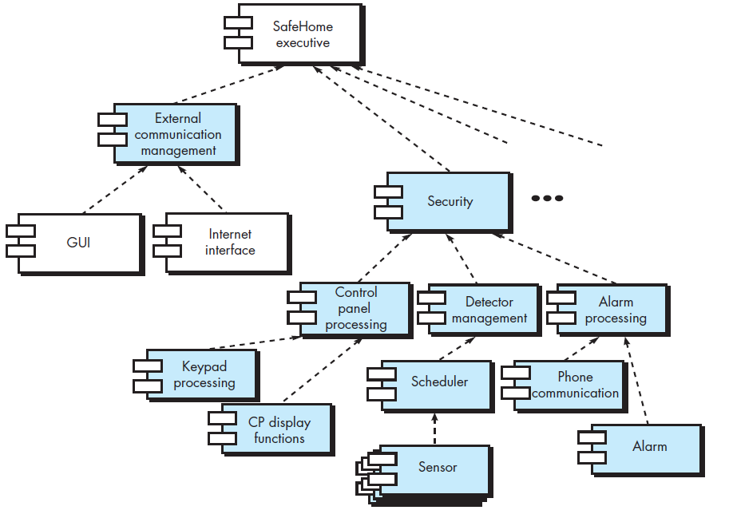
An instantiation of the security function with component elaboration

Slide 57
Summary
Software design commences as the first iteration of requirements engineering comes to a conclusion
The intent of software design is to apply a set of principles, concepts, and practices that lead to the development of a high-quality system or product
The goal of design is to create a model of software that will implement all customer requirements correctly and bring delight to those who use it
Software designers must sift through many design alternatives and converge on a solution that best suits the needs of project stakeholders

Slide 58
Summary: Design concepts emphasize…
The need for abstraction as a mechanism for creating reusable software components
The importance of architecture as a way to better understand the overall structure of a system
The benefits of pattern-based engineering as a technique for designing software with proven capabilities
The value of separation of concerns and effective modularity as a way to make software more understandable, more testable, and more maintainable
The consequences of information hiding as a mechanism for reducing the propagation of side effects when errors do occur
The impact of functional independence as a criterion for building effective modules
The use of refinement as a design mechanism a consideration of aspects that crosscut system requirements
The application of refactoring for optimizing the design that is derived
The importance of object-oriented classes and the characteristics that are related to them
The need to use abstraction to reduce coupling between components, and
The importance of design for testing

Slide 59
Summary
In a general sense, architectural design is accomplished using four distinct steps
First, the system must be represented in context
That is, the designer should define the external entities that the software interacts with and the nature of the interaction
Once context has been specified, the designer should identify a set of top-level abstractions, called archetypes, that represent pivotal elements of the system’s behavior or function
After abstractions have been defined, the design begins to move closer to the implementation domain
Components are identified and represented within the context of an architecture that supports them
Finally, specific instantiations of the architecture are developed to “prove” the design in a real-world context

